Slide 1
SAP HANA 2.0 Recovery

Slide 2
Recovery Options

Slide 3
Points
Prerequisites
To perform a recovery the following requirements must be met:
• The user must have the system privilege BACKUP ADMIN.
• The user must know the credentials of the <sid>adm operating system user.
• Before a recovery can start, all the data and log backups must be either accessible in the file system or available through the third-party backup tool.
• At least one data backup is needed.
To perform an SAP HANA database recovery. the following requirements must be met:
• The SAP HANA database software must be installed, so that an initial database exists. In a recovery situation, you can use the SAP HANA studio to restore customer-specific changes to this initial database.
• Ensure that the target system and the source system have identical configurations. The number and types of services (for example, index server) on each host must be identical for both system landscapes.
• At the beginning of a recovery, all the data and log backups to be used must be either accessible in the file system or available through the third-party backup tool.
• At least one data backup must be available before the recovery is started.
• To restore the database to a particular point in time. a data backup and all the log backups up to the point in time for recovery are needed (including the log backups made after the desired point in time of the recovery).
• Recovery to a lower system release is not possible.

Slide 4
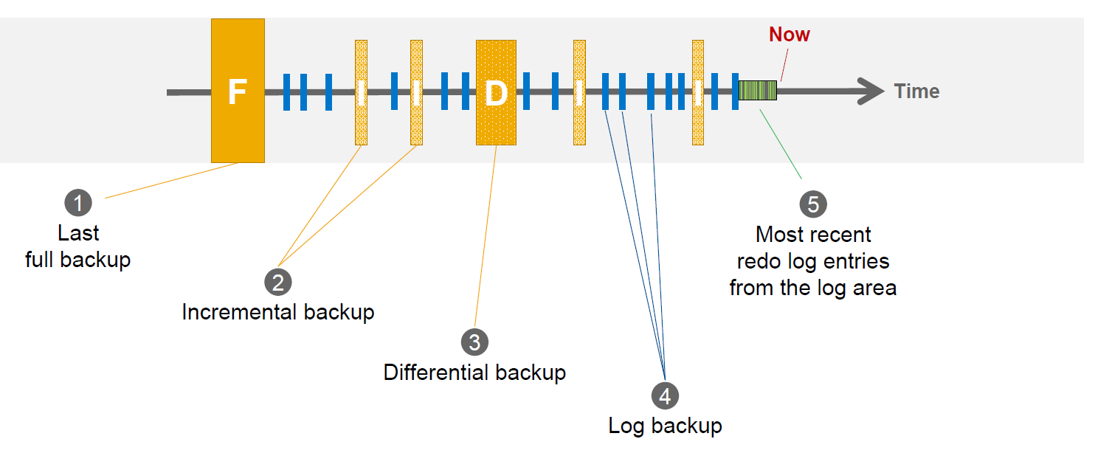
Backups during normal operation

Slide 5
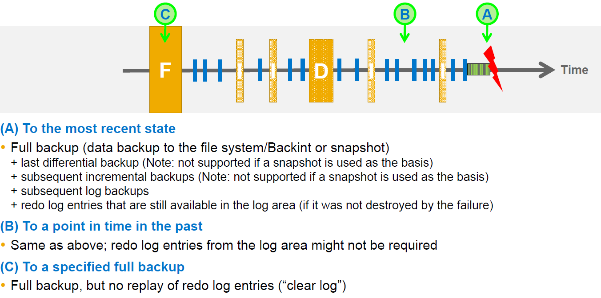
Recovery options

Slide 6
Recovery with SAP HANA Multitenant Database Containers
For a recovery with SAP HANA multitenant database containers, note the following information:
To perform a recovery, an SAP HANA database needs to be shut down.
To recover a complete SAP HANA system, the system database needs to be recovered first, and then all the tenant databases are recovered individually.
The recovery of a tenant database is always initiated from the system database. If tenant databases need to be recovered, they are recovered individually, and not all together in one single operation.
If a tenant database is shut down for recovery the system database and any other tenant databases remain online.
The system database only needs to be recovered if it is corrupted. If only a tenant database is corrupted, the system database does not need to be recovered.
If the system database is shut down for recovery all its tenant databases are automatically shut down as well.
To recover a database, at least one full backup (data backup or data snapshot) must be available.
When an SAP HANA multitenant database container is recovered, the services needed are generated automatically in the tenant database
With SAP HANA 2.0, an SAP HANA single-container system can be recovered to a tenant database.
An SAP HANA database cannot be recovered to an SAP HANA database with a lower software version.

Slide 7
Recovering a Tenant Database
To recover a tenant database, proceed as follows:
Recovery of tenant databases can only be initiated from the system database.
The system database and other tenant databases are not affected.
Select the tenant database to be recovered.
Specify your recovery type and further recovery settings, and start the recovery.
Recovering the System Database
To recover the system database, proceed as follows:
The whole system is shut down, including all tenant databases.
Specify your recovery type and further recovery settings, and start the recovery.
The system database is recovered and restarted.
Restart the tenant databases.
The content of the tenant databases is not affected by the system database recovery
If tenant databases need to be recovered, they are recovered individually, and not all together in one single operation.

Slide 8
Recovery with SAP HANA Cockpit
To recover an SAP HANA database, perform the following steps:
1.In the SAP HANA cockpit, choose the following:
Overall Tenant Statuses, select the tenant database from the overview and choose Recover Tenant.
Recover Database to recover the system database.
2.Specify the recovery type from one of the following:
Recover the database to the most recent state
Recover the database to a specified point in time
3.Specify the location of the most recent backup catalog. An overview of the available full backups is displayed.
4.Select the complete data backup to be used for the recovery.
5.Specify whether to use delta backups.
6.If you are using backups that differ from those recorded in the backup catalog, specify their locations.
7.Check whether the backups are available. Decide if SAP HANA checks before the recovery starts if all the backups are available and if they can be accessed.
8.Specify whether to initialize the log area. If you initialize the log area, the content of the log area is lost. No log entries from the log area can be replayed during the recovery. The log entries from the log backups are replayed if they are needed. Initialize the log area when the log area is unusable or when you are recovering the database to a different system.
9.Choose Review. An overview of the recovery settings displays. To change any settings, choose Edit. All the settings that you specified are retained until you change them.
10.To display the SQL statement that is used for the recovery, choose Display SQL Statement.
11.Choose Start Recovery. The progress of the recovery for each SAP HANA service displays. When the recovery is complete, a message confirms this, and shows the timestamp to which the recovery was completed. The database is restarted automatically after the recovery.

Slide 9
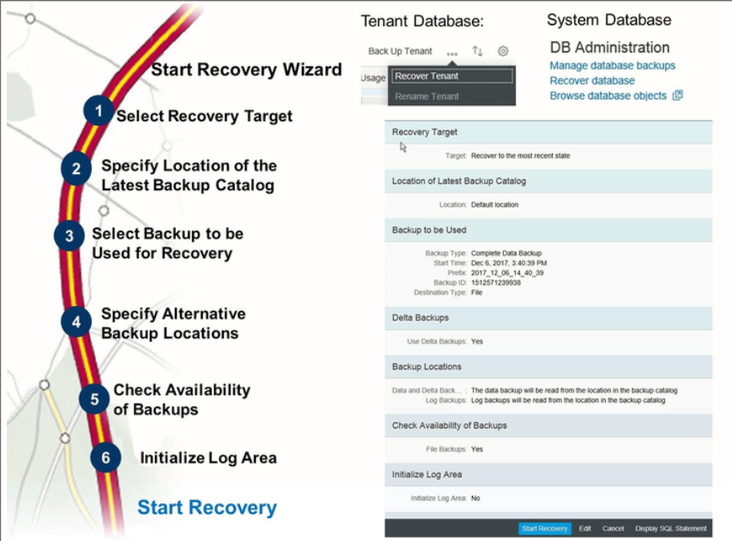
Performing Recovery

Slide 10
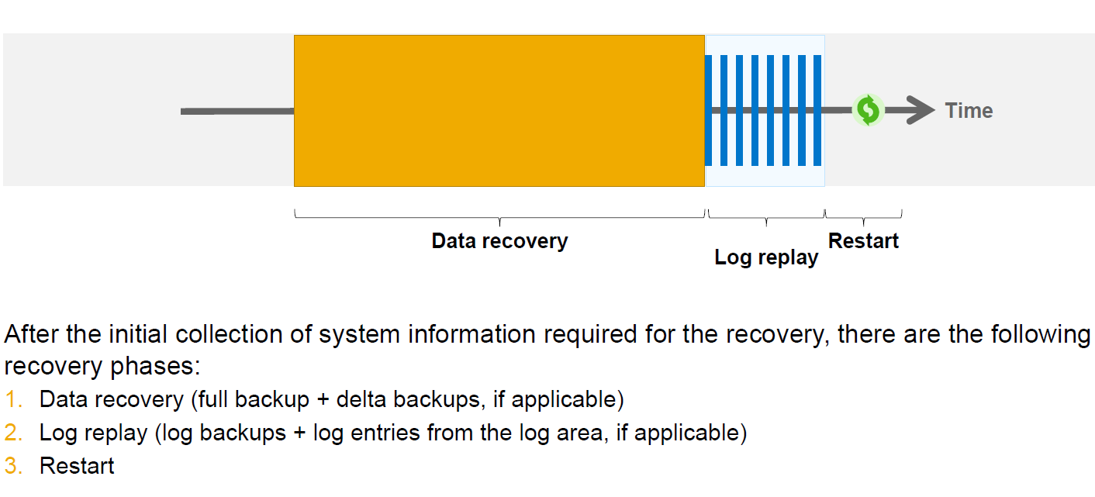
Recovery phases

Slide 11
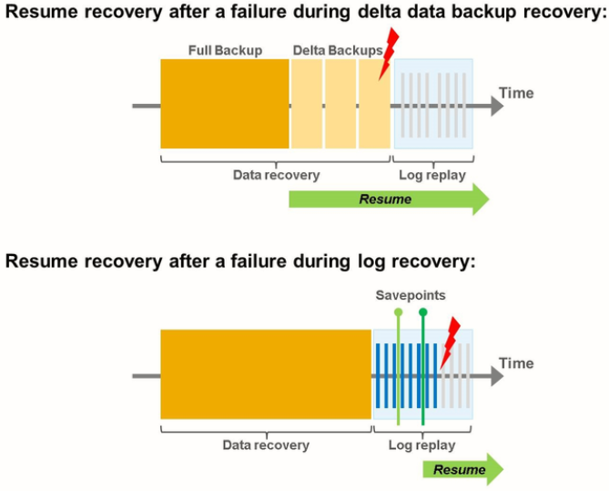
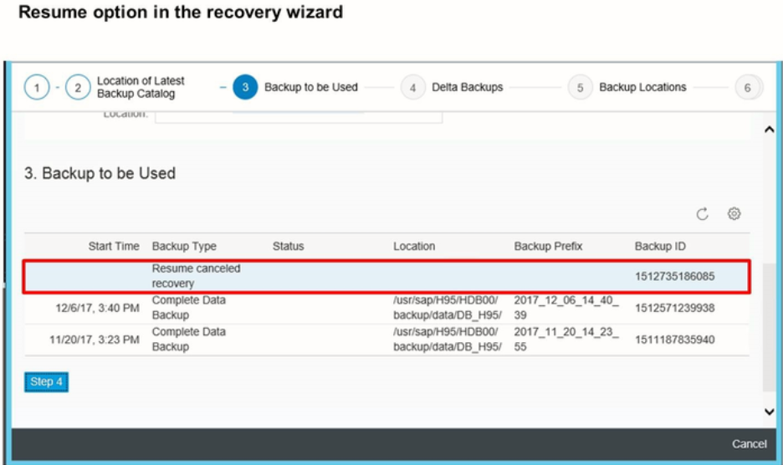
Resume recovery after error

Slide 12
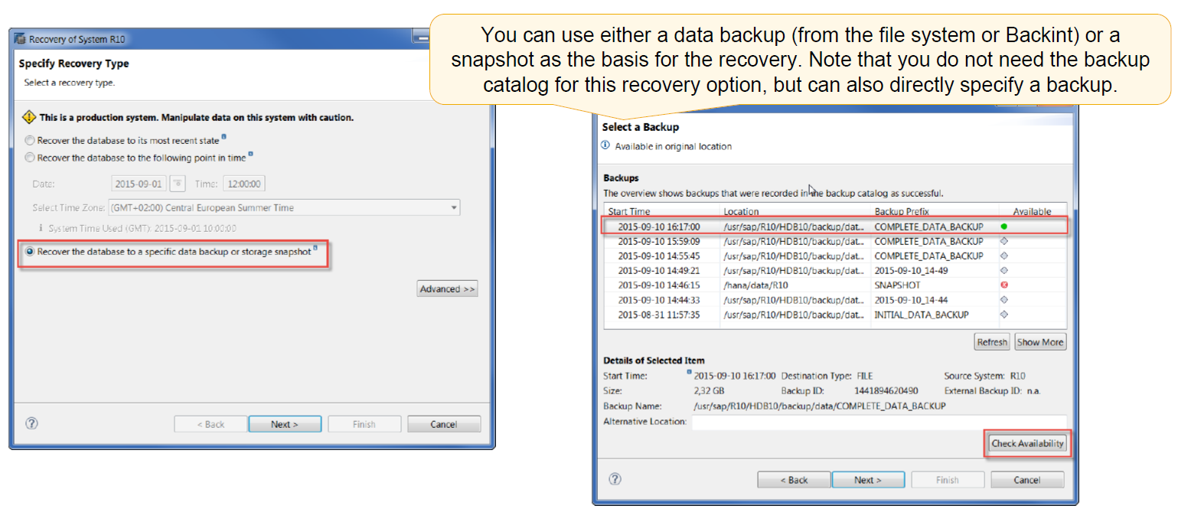
Recovery using a specified data backup or snapshot

Slide 13
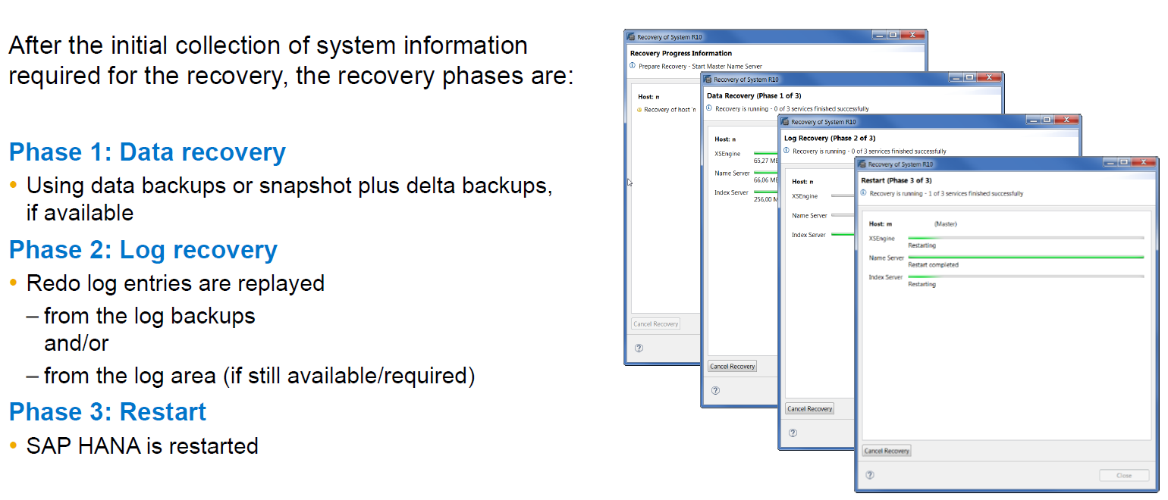
Recovery phases

Slide 14
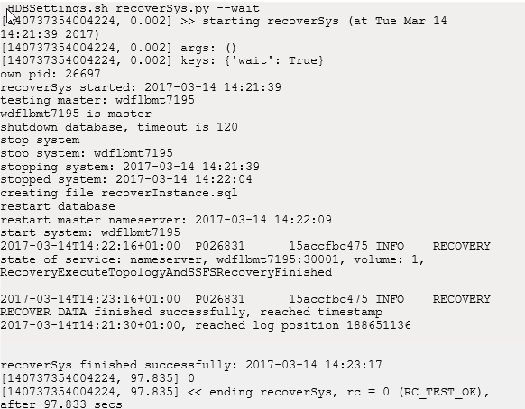
From Command Line

Slide 15
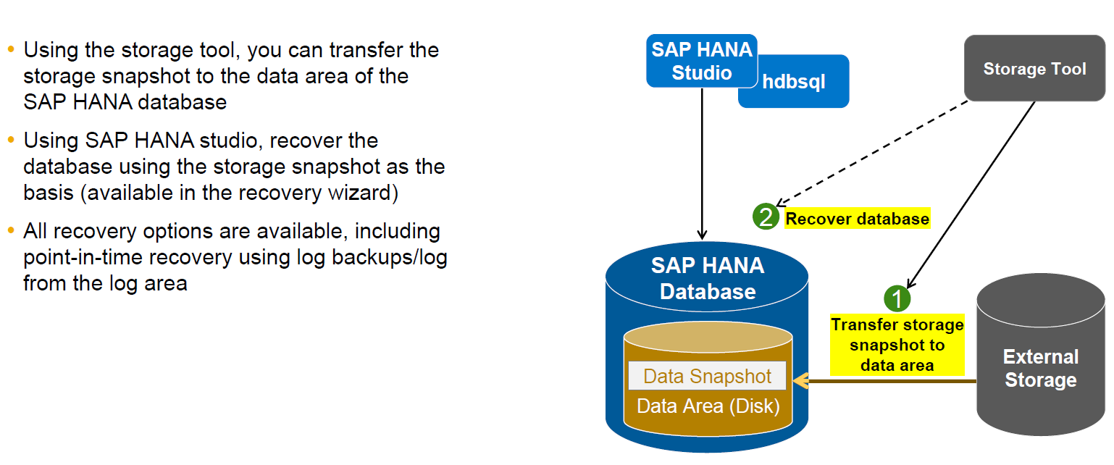
Recovery steps when using a storage snapshot (1)

Slide 16
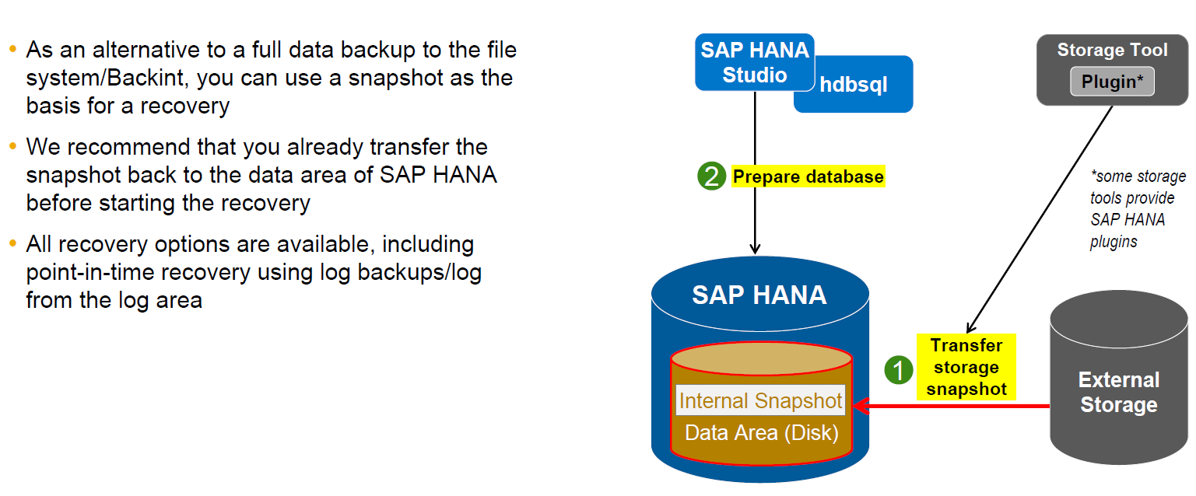
Recovery steps when using a storage snapshot (2)

Slide 17
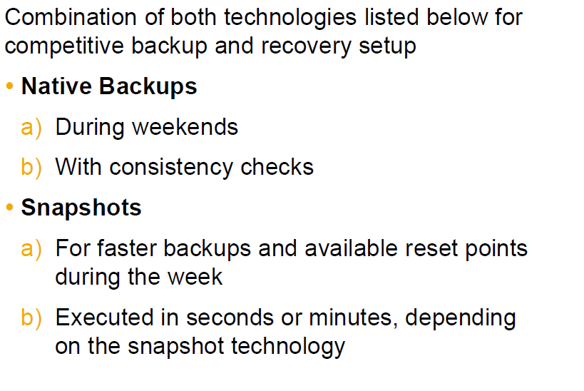
Recommendations

